Slide 1

“P2P Revenue optimization for Lenders”
Presented by:
Group 10
BABI (Oct 19 Batch)
Raunak Rudra
Saurav Banerjee
Shraddha Chaudhari
Thokchom Joychandra Singh
Mentor:
Nimesh Mafartia

Slide 2
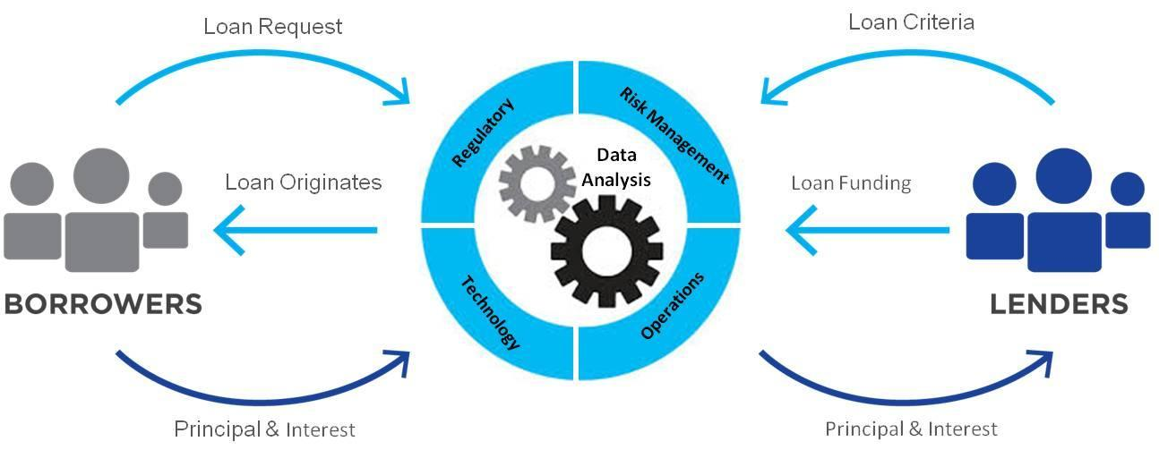
P2P Lending
Peer-to-Peer (P2P) Lending, as the name suggest is the practice of lending money among peers
It is the practice of lending money to individuals or businesses through online services that match lenders with borrowers. Peer-to-peer lending companies often offer their services online, and attempt to operate with lower overhead and provide services more cheaply than traditional financial institutions
Easy loan process and easy to avail
P2P Lending platforms offer help to a segment of the population that otherwise might not be able to get a loan the traditional way, without any hidden costs but there is additional risk of the borrower defaulting on the loans taken out from peer-lending websites.
Fig: P2P Lending cycle

Slide 3
P2P Lending – Pros and Cons
Pros
Cons
Higher Returns: P2P lending generally provides higher rate or returns to investors as compared to other forms of investments
Ease of Accessibility: P2P are more easily accessible for some borrowers as compared to conventional loans especially for borrowers with low credit rating
Credit Risk: P2P loans are exposed to higher credit risk. Since there could be borrowers with low credit ratings, they are more prone to loan default
Unsecured Loans: There are no proper rules set for the protection of lenders against defaults.

Slide 4
Why Lending Club ?
Lending Club is the 2nd biggest player in the P2P lending market in US
Lending Club is the first P2P lender to register its offering as securities with the SEC
Lending Club has issued over $59B USD till March 2020
Lending Club data can be collected easily through their public APIs

Slide 5
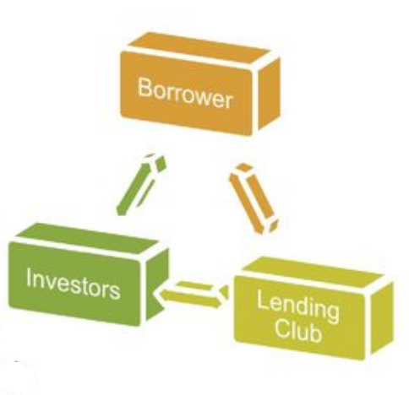
Identifying the Business Problem
Lending Club is a P2P lending platform which funds loan requests through a group of private investors
Lending Club’s risk assessment model categorizes borrowers into grade and sub-grade on the basis of their credit history
Investors are given the opportunity to choose which borrowers they will fund and how much percentage of funding will they cover by analysing the associated risk
The need for study is that investors require a more comprehensive model that can identify loan defaults amongst new borrowers thereby giving them an opportunity to make smart investments ( maximizing returns and minimizing risk)

Slide 6
Scope and Objective
Scope for the project:
The data used for this project is based on the Lending Club dataset for the year 2007-2017
Loan Default rates and their subsequent impact on the model is limited to the information available in the dataset and does not take into consideration extraneous economic factors https://www.lendingclub.com/
Objectives of project:
Create a classification model for identifying defaulters
Grouping borrowers into risk buckets of High, Medium and low
Developing a model which will maximize the ROI for Lenders
Create an optimization model thereby creating loan baskets for Lenders

Slide 7
Data Source and Description
Data was sourced from the official website of Lending Club with API
Publicly available data from “2007-2017” was considered
“2007-2015” is used for Training
“2016-2017” data is used for validation (test data)
A total of 1.7 Million Individual Loans were considered

Slide 8
Data Pre-Processing
The input file consists of 151 individual variable columns
Data Cleaning:
Deleted variables having 50% of missing data. This brought number of columns to 90
Removed id, member id, URL column as they would not have any significant bearing on the model.
Grade and Sub grade fields have been removed before running the model since we did not want the classification from Lending club of applicants to bias our independent classification model.
Data Leakage: Excluding all payments related columns in the dataset as there will be no payment information for new borrowers.

Slide 9
Data Pre-Processing – Contd..
Feature Engineering:
Created new column for loan age and dropped issue_d column. Age has been calculated as difference between issue date of loan and January 1st 2021.
Converted into fico score by taking average of fico_range_high and fico_range low from original dataset.
Cleaned Dataset variables:
loan_amnt | term | installment | home_ownership | annual_inc
verification_status | loan_status (predictor variable) | purpose | addr_state | dti
delinq_2yrs | open_acc | pub_rec | revol_bal | total_acc
initial_list_status | application_type | mort_acc | loan_age | fico_value
21 features are considered out of which there are 20 predictor variables and 1 dependent variable which is Loan_status.

Slide 10
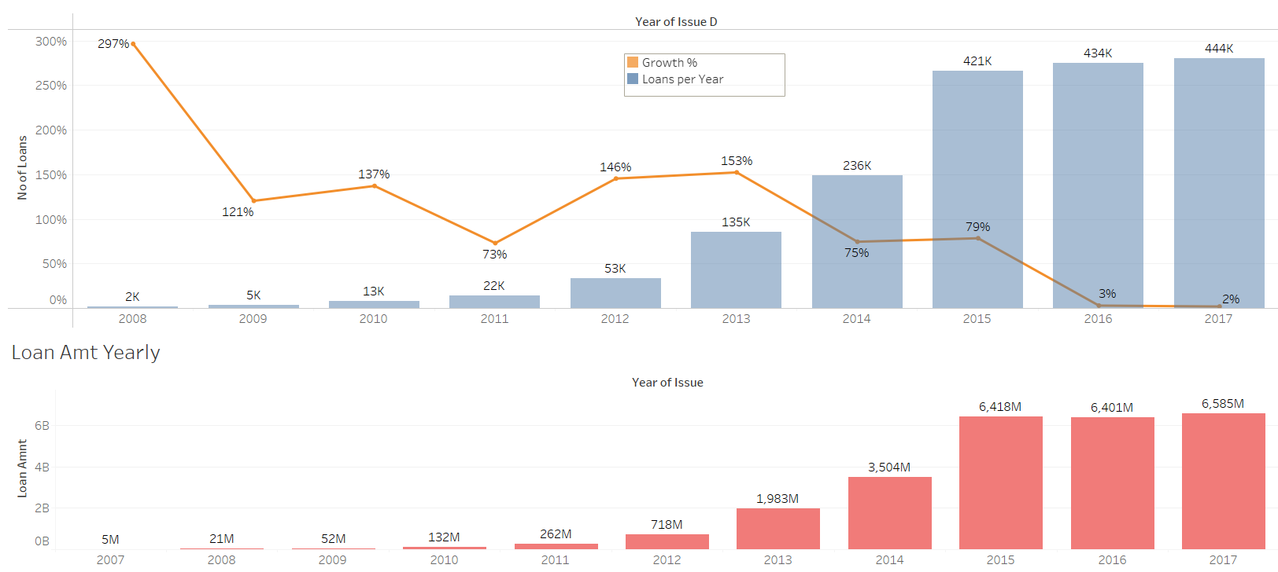
EDA
Loan Growth:
Although the number of loans has increased over the years; the growth% has flattened
Notes:
The data file contain complete loan data for all loans issued through the 2007-2015, including the borrower profile, current loan status (Current, Late, Fully Paid, etc.)
Additional features include credit scores, number of finance inquiries, address including zip codes, and state, and collections among others. The file is a matrix of roughly 1.7 million observations and 150 variables.
The time series plot above shows a rising popularity of loan lending after 2011. The trend explodes until 2015 but then has become stable in 2016 & 17 thus showing the growth % has more or less flattened now.
We see a similar trend with loam amount as well, where loan amount has been above 6 Billion USD in last 3 years

Slide 11
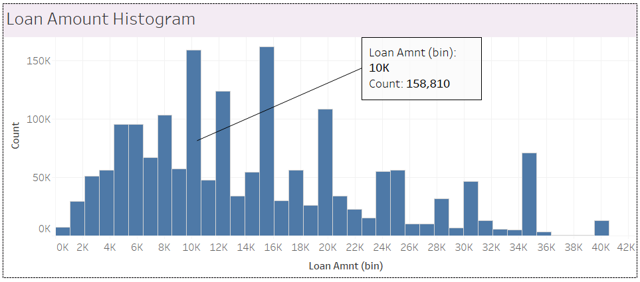
EDA Contd..
Loan Amount:
Loan amounts range from 1000$ to $40000 with a median of $12000 for fully paid loans and $14975 for charged off loans
Notes:
Loan amounts range from 1000$ to $40000 , The distribution of loan amount is slightly skewed to the right. Most borrowers applied loan of around $10,000 or $15000. The median of $12000 for fully paid loans and $14975 for charged off loans

Slide 12
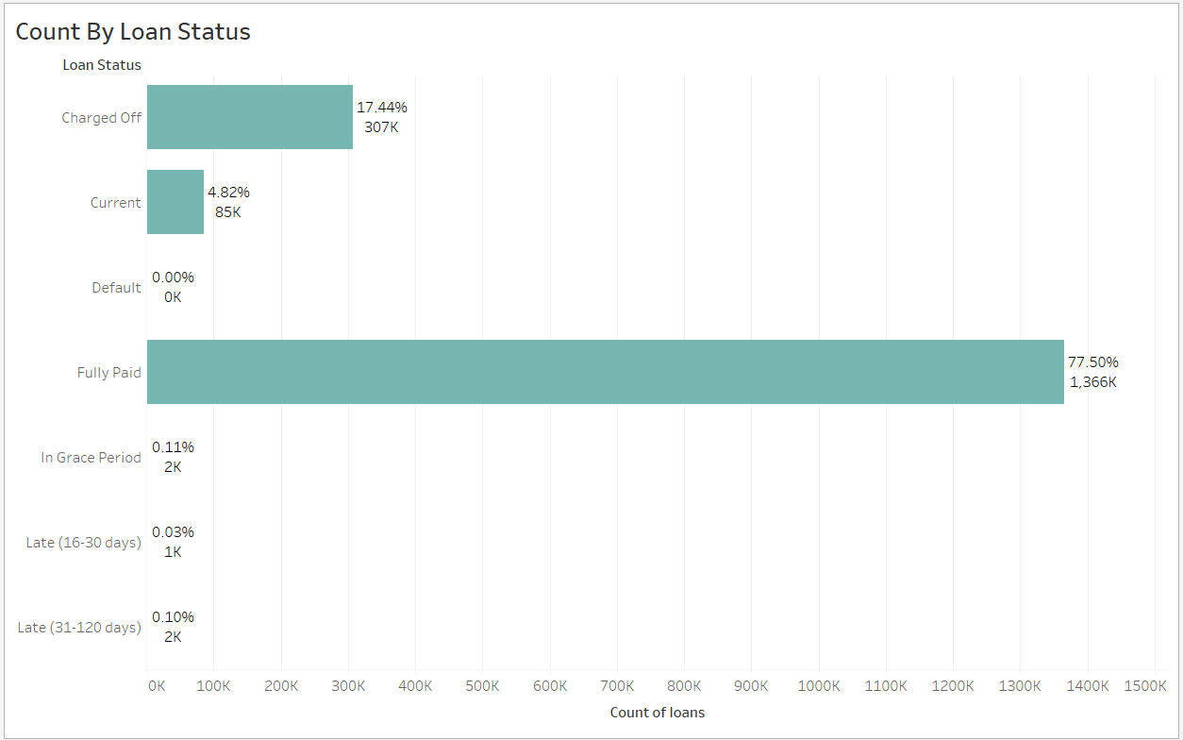
EDA Contd..
Loan Status:
Notes:
The dataset that we have is imbalanced towards Fully Paid loans which constitute 77% of data points. We also have other status such as current, In Grace period etc which we will be excluding for our modelling and analysis

Slide 13
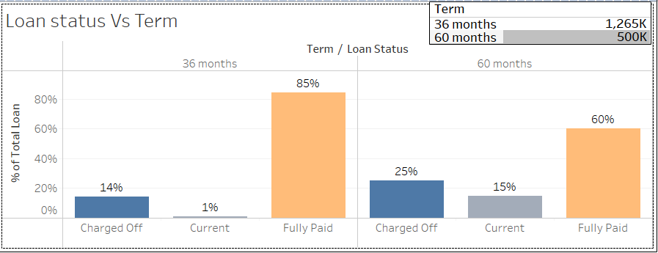
EDA Contd..
Loan Term:
Out of the total 1765K loans being granted, 1265K Loans are of 36 months term and remaining 500K have taken loans for a term period of 60 months.
Notes:
Out of the total 1765K loans being granted, 1265K Loans are of 36 months term and remaining 500K have taken loans for a term period of 60 months thus 3 year term is more popular among borrowers. We can observer that with 5 year term loan the percentage of charge off has jumped from 14 to 25 % so there is more chance of loan default with 5 year term loan

Slide 14
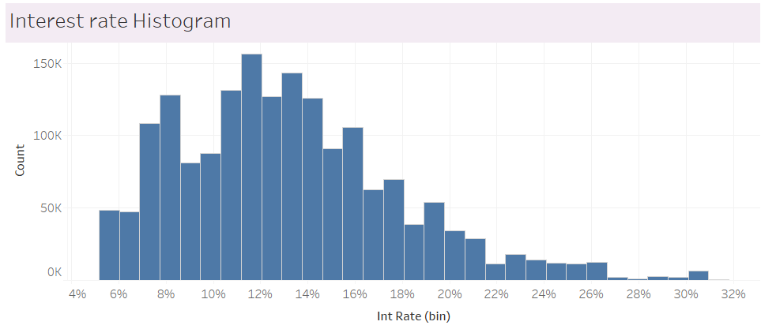
EDA Contd..
Interest Rate:
The interest rate of the loans ranges from 5% to 32 % with a median of 12% for fully paid loans and 15% for charged off loans.
Notes:
The interest rate of the loans ranges from 5% to 32 % with a median of 12% for fully paid loans and 15% for charged off loans.

Slide 15
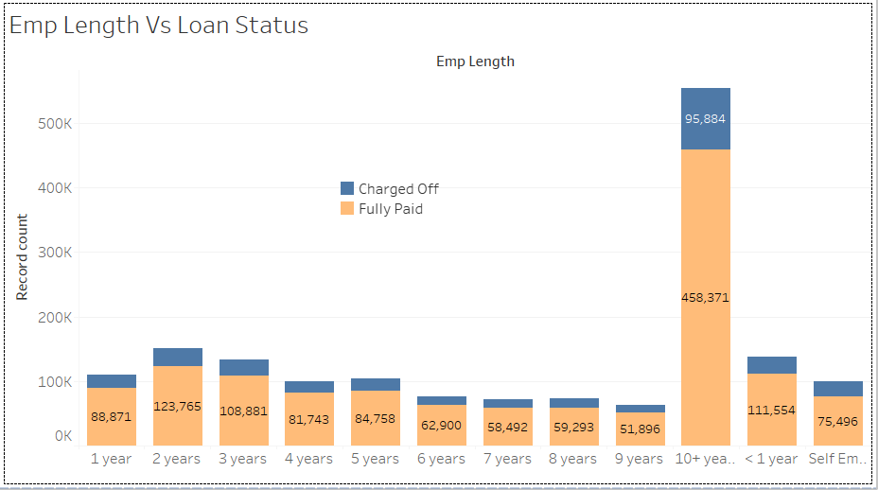
EDA Contd..
Employment Length:
Highest number of loan takers has more than 10+ years of work experience. . Employment time span doesn’t seem to have a significant correlation between employment lengths and charged off.
Notes:
Borrowers who work more than 10 years makes up a large proportion of the borrower population. Employment time span doesn’t seem to have a significant correlation between employment lengths and charged off however we see slightly higher charge offs with Self employed applicants.

Slide 16
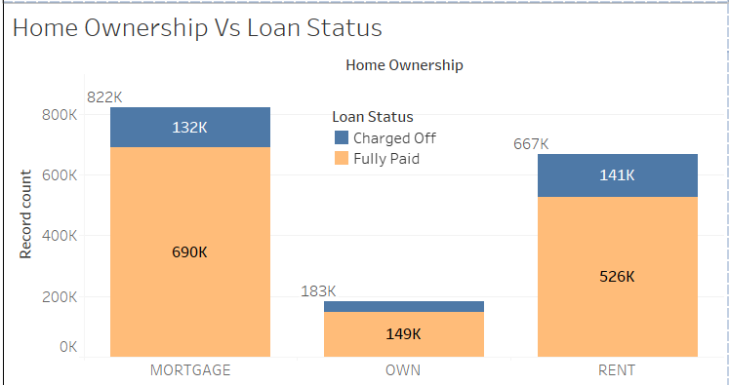
EDA Contd..
Home Ownership:
Home ownership here represents the home ownership status provided by the borrower during registration or obtained from the credit report. The values are: Mortgage, Own and Rent
16%
21%
19%
Notes:
60 % population either own a home or have mortgage loans, we see slightly higher charge off rates for applicants who are renting
Mortgage 16% >> Own 18.72% >> Rent 21.12%

Slide 17
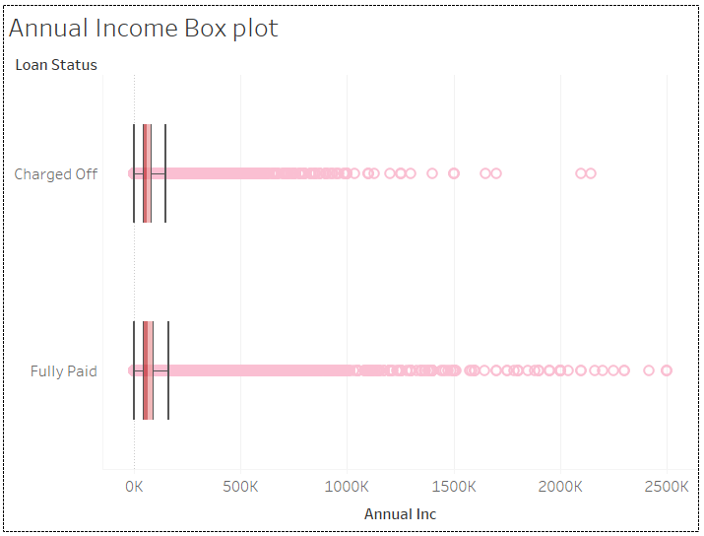
EDA Contd..
Annual Income:
Annual Income does not have a lot of impact on the loan paying capabilities
Notes:
Annual Income does not have a lot of impact on the loan paying capabilities, we can see that individuals with higher income as well are defaulting on loan payments. Median annual income of all the applicants comes around $65K but we see HNI having a salary up to 110 million also applying loans through P2P.

Slide 18
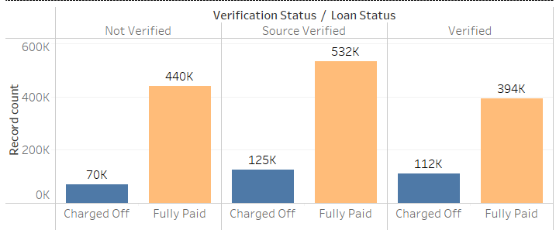
EDA Contd..
Verification Status:
Verification status represents whether the income was verified or not. It doesn’t seem to have any relation with charge-off
14%
19%
22%
Notes:
Verification status represents whether the income was verified or not. It doesn’t seem to have any relation with charge-off, If anything Verified loan status has higher percentage of charge offs. This posed a question on Lending club on how they are verifying the loan applicants and their source of income.

Slide 19
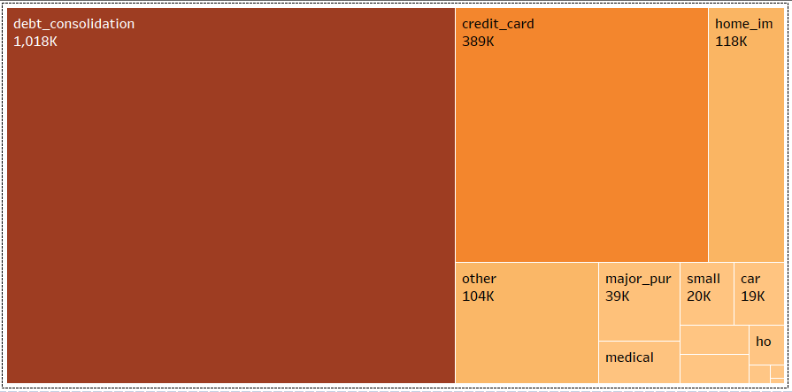
EDA Contd..
Purpose:
Most of the borrowers in the data has borrowed money for debt consolidation purposes
Notes:
The most common reason for a loan request is debt consolidation, followed by credit card and home improvement and they account for almost 90% of loans applied.

Slide 20
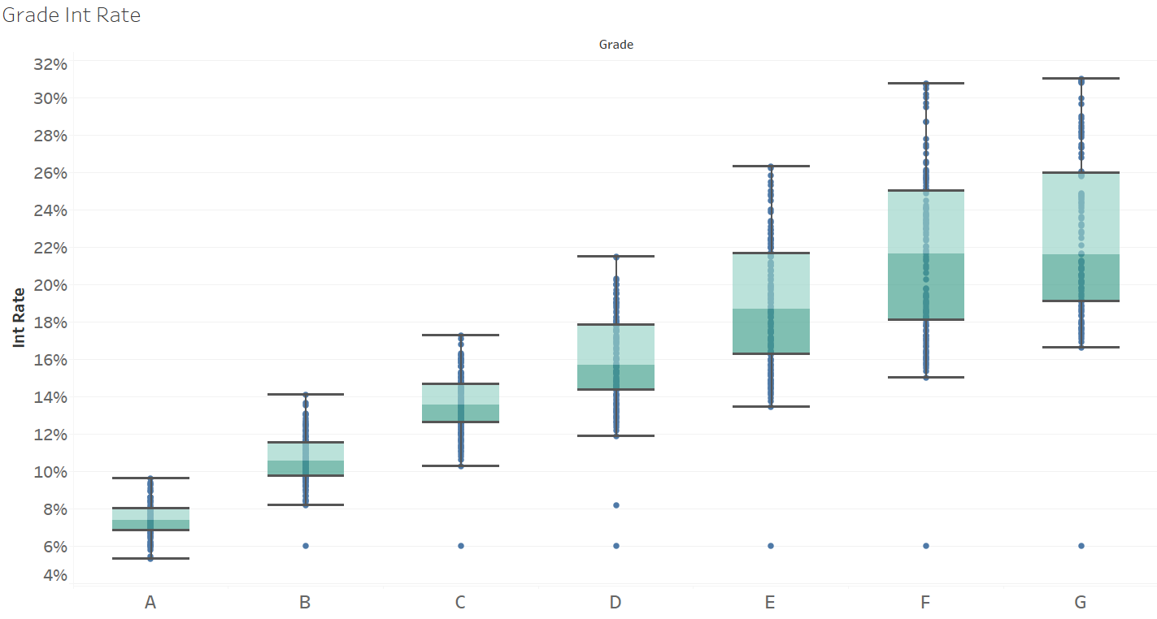
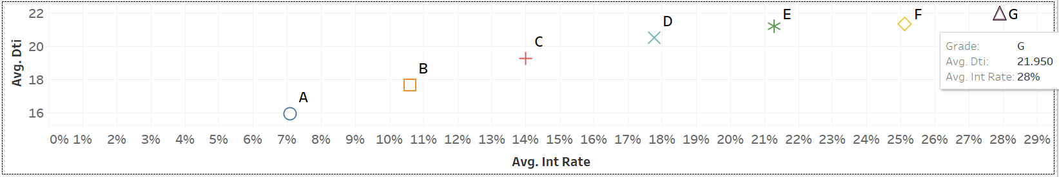
EDA Contd..
Grade & Debt To Income (DTI) ratio:
Lower the grade, higher is the interest rate & debt to income ratio
Notes:
Loans are graded based on borrowers' credit scores. Grade A applicants have good credits and lower risks and vice versa for Grade G.
We can see that as we move from Grade A to G , average interest rate and dti increases. This makes sense since we have higher risks with lower grades.

Slide 21
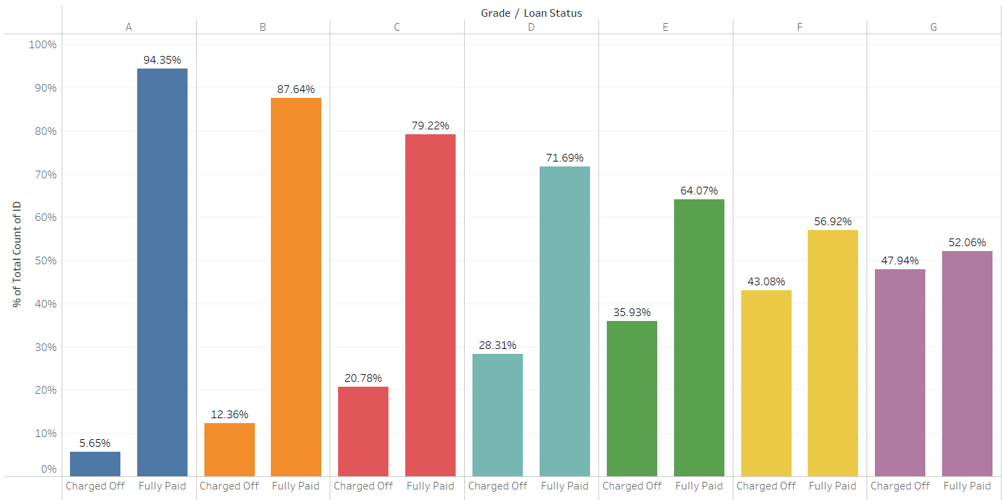
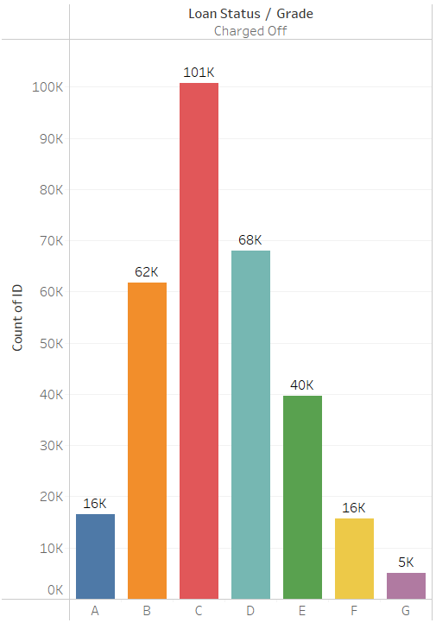
EDA Contd..
Notes:
In the next slide we can see that how charged off % share increases from Grade A to Grade G where in ‘G’ it is almost 50%.
Maximum charge off happened in Grade ‘C’ – Two reasons for that , Grade C contributes to 2 highest data points and there is a significant jump in charged off % from 12% in Grade B to 21 % in Grade C

Slide 22
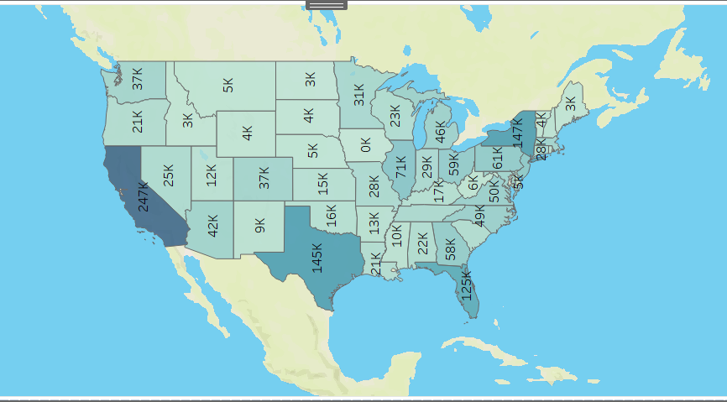
EDA Contd..
State-wise Loan Distribution:
California has the highest number of borrowers with a total of 274K borrowers
Charge off % Varies from 16 – 22% for all the states
Notes:
California has the highest number of borrowers with a total of 274K borrowers. There was no alarming trend in terms of a particular state defaulting a lot, the charged off % ranged from 16 % to 22% across states. Mississippi had highest charge off rate of 22%

Slide 23
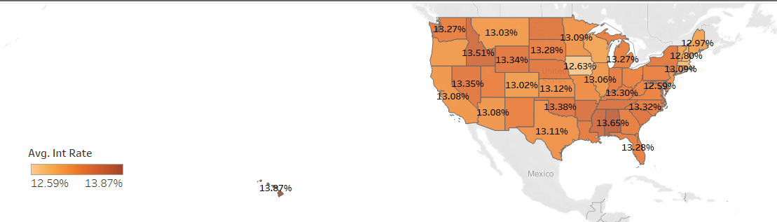
EDA Contd..
State-wise Average Interest Rate:
Hawaii has highest average interest rate of 13.87%
Notes:
Average interest rate ranges from 12.59 % to 13.87 across states. Hawaii has highest average interest rate of 13.87%

Slide 24
Modelling Approach
Using the data provided, we will be implementing below models to classify the loans into defaults
Decision Tree
Random Forest
Logistic Regression
Naïve Bayes
Linear Discriminant Analysis
The model’s performance will be measured using AUC & Confusion Matrix
Since our objective is to measure the predicted loan default accurately, sensitivity or recall is the important metric
Before running the models we will be treating the data imbalance
82% of the loans are fully paid whereas only 18% of the loans are charged off
Over Sampling is used to treat the data imbalance thereby bring the charge off percent to 50%

Slide 25
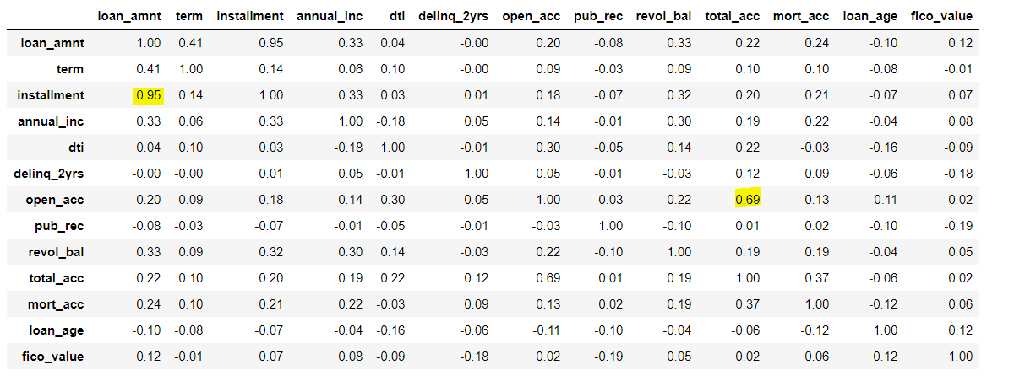
Modelling Approach Contd..
Below test has been performed on data .
Pearson Correlation: This test has been performed to check correlation between variables .
open_acc and total_acc are corelated with 69% correlation while loan_amnt and Instalments are correlated with 95% correlation
Variance Inflation Factor (VIF) :
Performed to test for multicollinearity.
It seems higher values for loan_amnt and installment for VIF so removed installment for Naïve Bayes, Logistic regression and LDA because they are impacted by multicollinearity

Slide 26
Model Performance Comparison
Description | Decision Tree | Naïve Bayes | Logistic regression | LDA | Random Forest
sklearn Package | DecisionTreeClassifier | GaussianNB | Logistic Regression | Linear Discriminant Analysis | RandomForestClassifier
No of Predictors | 20 | 20 | 20 | 20 | 20
Train Data – Year | 2007-15 | 2007-15 | 2007-15 | 2007-15 | 2007-15
Train Data – No of Observations | 883,760 | 883,760 | 883,760 | 883,760 | 883,760
Test Data – Year | 2016-2017 | 2016-2017 | 2016-2017 | 2016-2017 | 2016-2017
Test Data – No of Observations | 791,870 | 791,870 | 791,870 | 791,870 | 791,870
Accuracy | 62.96% | 58.87% | 61.46% | 62.26% | 61.13%
Sensitivity | 42.69% | 63.7% | 61.58% | 55.21% | 64.21%
Specificity | 67.70% | 57.88% | 61.44% | 63.90% | 60.41%
AUC | 56.397 | 65.01 | 66.07 | 63.19% | 67.40

Slide 27
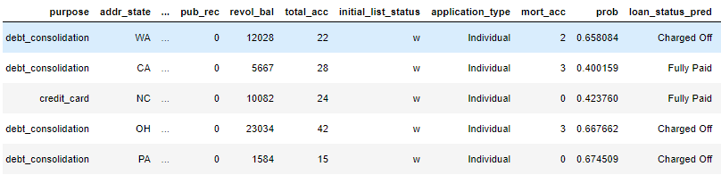
Credit Risk Model: Probability of Default (PD)
Probability of Default means the likelihood that a borrower will default on Debt over a one year period.
The predicted probability from Logistic Regression model has been used as input to the Probability of Default model
Higher the default probability, higher the chances of default and higher the interest rate the lender will charge the borrower

Slide 28
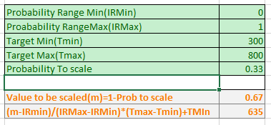
Risk Score Calculation
We have used probability predictions from Logistic Regression as input for the Probability of Default model.
The Class of Interest is the “Charged Off” class and therefore the higher the probability output from Logistic Regression, higher the chances of loan default.
Therefore, for the risk score calculation, we have used 1-Probability of default (1-p) as we wanted lower risk for the investor. So, lower the risk score, higher the probability of default.
Since the probability always lies between 0 and 1, we have used the min-max scaler to scale the computed probability for the applicants between 300-800 score range ( this is an arbitrary range and can be changed) which is used as the risk score for the loan applicant.

Slide 29
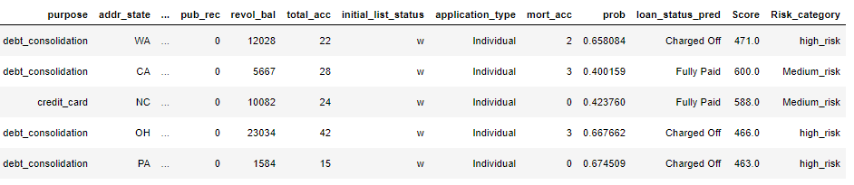
Risk Profile
The above computed scores are used to classify loan applicant into three categories. Scoring classes are given below:
High Risk : Score range of 300-500
Medium Risk: Score range of 500-650
Low Risk: Score range of 650-800

Slide 30
Lending Club V/S Our Model on Random Sample
loan_amnt | term | int_rate | grade | sub_grade | loan_status_x | prob | loan_status_pred | Score | Risk_category
12500 | 60 | 7.39% | A | A4 | Charged Off | 0.665413822 | Charged Off | 467 | high_risk
16500 | 60 | 9.75% | B | B3 | Charged Off | 0.65516018 | Charged Off | 472 | high_risk
14000 | 60 | 9.16% | B | B2 | Charged Off | 0.690868077 | Charged Off | 455 | high_risk
15000 | 60 | 9.75% | B | B3 | Charged Off | 0.652756497 | Charged Off | 474 | high_risk
16000 | 60 | 9.75% | B | B3 | Charged Off | 0.643203606 | Charged Off | 478 | high_risk
20000 | 60 | 9.75% | B | B3 | Charged Off | 0.630065333 | Charged Off | 485 | high_risk
27000 | 60 | 8.39% | B | B1 | Charged Off | 0.606259142 | Charged Off | 497 | high_risk
40000 | 60 | 9.75% | B | B3 | Charged Off | 0.620740061 | Charged Off | 490 | high_risk
10000 | 60 | 11.47% | B | B5 | Charged Off | 0.731325577 | Charged Off | 434 | high_risk
15000 | 60 | 11.47% | B | B5 | Charged Off | 0.69362153 | Charged Off | 453 | high_risk
25000 | 60 | 9.75% | B | B3 | Charged Off | 0.651345211 | Charged Off | 474 | high_risk
16000 | 60 | 11.47% | B | B5 | Charged Off | 0.671353536 | Charged Off | 464 | high_risk
16000 | 60 | 7.39% | A | A4 | Charged Off | 0.657492869 | Charged Off | 471 | high_risk
12000 | 60 | 10.75% | B | B4 | Charged Off | 0.621545772 | Charged Off | 489 | high_risk
33000 | 60 | 11.47% | B | B5 | Charged Off | 0.604094969 | Charged Off | 498 | high_risk
12000 | 60 | 9.75% | B | B3 | Charged Off | 0.696664923 | Charged Off | 452 | high_risk
20000 | 60 | 9.75% | B | B3 | Charged Off | 0.68481585 | Charged Off | 458 | high_risk
25000 | 60 | 8.39% | B | B1 | Charged Off | 0.683773314 | Charged Off | 458 | high_risk
20000 | 60 | 11.47% | B | B5 | Charged Off | 0.688300122 | Charged Off | 456 | high_risk

Slide 31
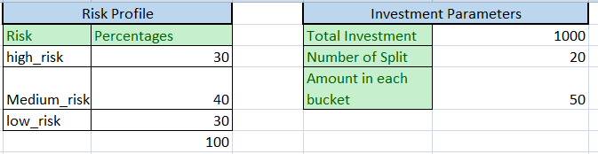
Portfolio Optimization
Optimization Technique is used to calculate the maximum profit based on Lender’s preference
A prototype using Excel Solver using a random sample of 60 loan applicants where investors choose percentage of High, Medium and Low Risk based on their risk appetite is created
The number of investment buckets and total investments can be chosen by investor to suit their profile
Based on user’s selection the solver maximizes the total revenue keeping the constraint of percentage selection of risk profile loans selected by user and at the same time provides best loan applicants which investors can choose
Working file:

Slide 32
Application & Future Scope
Challenge
Insights
489K loans have interest rate above 15% - largely contributing to loan defaults (31%)
22% of verified loans have defaulted
Probability of default (PD) based model can be used as a prediction mechanism for loan default
Recommendations
Using the Probability of Default(PD) a optimal portfolio strategy can be created based on user risk profile
Higher Interest Rates
Optimal Strategy for portfolio creation
High loan default rate on ‘Verified loans’
Future scope - Interest rate optimization to reduce loan default and customer churn
Future scope - Use of social parameters for predicting loan default
Improve verification process

Slide 33
THANK YOU

Slide 34
Appendix

Slide 35
Modelling Approach – Assumptions for Statistical Models
Assumption of appropriate outcome structure: In the given dataset dependent variables “Fully Paid” and “Charged Off” are converted into binary “0” and “1” respectively.
Assumption of independence of observation: Assumed the observations to be independent of each other. In given dataset each observation is independent as each row of data belongs to a different customer
Assumption of absence of multicollinearity: Logistic Regression and Naïve Bayes requires there to be no multi-collinearity while Tree based algorithms are not impacted by multicollinearity. In given dataset correlation between loan_amnt and installment is high (95%) and also between total_acc and open_acc is 69% .So we have removed installment and open_acct features.
Assumption of large data size: Machine Learning models typically requires a large size sample. Given dataset has 887442 lines of records in the training dataset

Slide 36
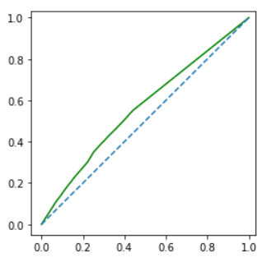
Decision Tree
Decision trees tend to over fit, especially when the tree is deep and leaf nodes comprise too few attributes.
The model decision tree was created using the DecisionTreeClassifier and ‘entropy’ criterion with a max depth of 18 was used to build an appropriate decision tree for selecting the best splitter.
Hyper parameter tuning is used and the best model performance was obtained at 0.30 cut-off
AUC obtained after running the final model is 56.39
Confusion Matrix
 | Model Prediction
Actual loan status |  | No Default | Default
 | No Default | 434595 | 207275
 | Default | 85956 | 64044
Fig: AUC Plot
Accuracy of the model is 62.96%
Sensitivity of the model is 42.69%
Specificity of the model is 67.70%

Slide 37
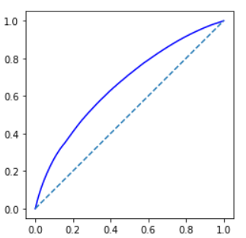
Logistic Regression
Logistic Regression from sklearn library was used creating the logistic regression model and SMOTE from imblearn was used to remove the data imbalance.
Hyper parameter tuning was used and Probability of default was kept as 0.48 for cut-off to obtain best model performance.
AUC obtained after running the final model is 66.07%
Confusion Matrix
 | Model Prediction
Actual loan status |  | No Default | Default
 | No Default | 394386 | 247484
 | Default | 57625 | 92375
Fig: AUC Plot
Accuracy of the model is 61.46%
Sensitivity of the model is 61.58%
Specificity of the model is 61.44%

Slide 38
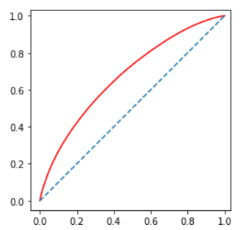
Random Forest
Ensemble of Decision Trees (RandomForestClassifier in sklearn): Random Forest model was created with ‘gini’ criterion and min_samples_leaf=1, min_samples_split=2
Hyper parameter tuning was used and Probability of default was kept as 0.23 for cut-off to obtain best model performance.
AUC obtained after running the final model is 67.40%
Confusion Matrix
Confusion Matrix | Model Prediction
Actual loan status |  | No Default | Default
 | No Default | 387771 | 254099
 | Default | 53682 | 96318
Accuracy of the model is 61.11%
Sensitivity of the model is 64.21%
Specificity of the model is 60.41%
Fig: AUC Plot

Slide 39
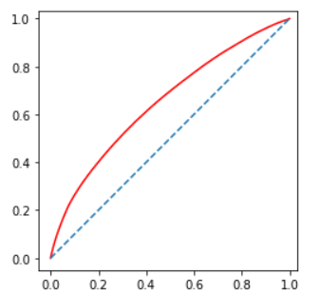
Naïve Bayes Algorithm
Naive Bayes is a technique based on Bayes theorem of conditional probability for constructing classifiers: models that assign class labels to problem instances, represented as vectors of feature values, where the class labels are drawn from some finite set. The default loan probability is explained by the 20 variables that were considered as independent features. GaussianNB from sklearn package was used for building the model. Hyper parameter tuning was used and Probability of default was kept as 0.60 for cut-off to obtain best model performance.
AUC obtained after running the final model is 65.01%
Confusion Matrix
Fig: AUC Plot
 | Model Prediction
Actual loan status |  | No Default | Default
 | No Default | 371542 | 270328
 | Default | 55350 | 94650
Accuracy of the model is 58.87%
Sensitivity of the model is 63.1%
Specificity of the model is 57.88%

Slide 40
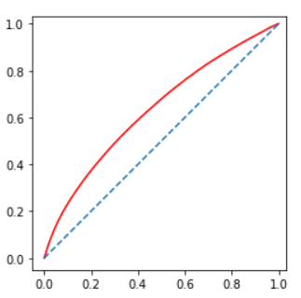
Linear Discriminant Analysis
Linear Discriminant Analysis (LDA) Hyper parameter tuning was used and Probability of default was kept as 0.50 for cut-off to obtain best model performance.
AUC obtained after running the final model is 63.19%
Confusion Matrix
 | Model Prediction
Actual loan status |  | No Default | Default
 | No Default | 410217 | 231653
 | Default | 67181 | 82819
Accuracy of the model is 62.26%
Sensitivity of the model is 55.21%
Specificity of the model is 63.90%
Fig: AUC Plot

Slide 41
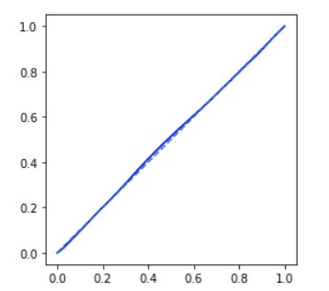
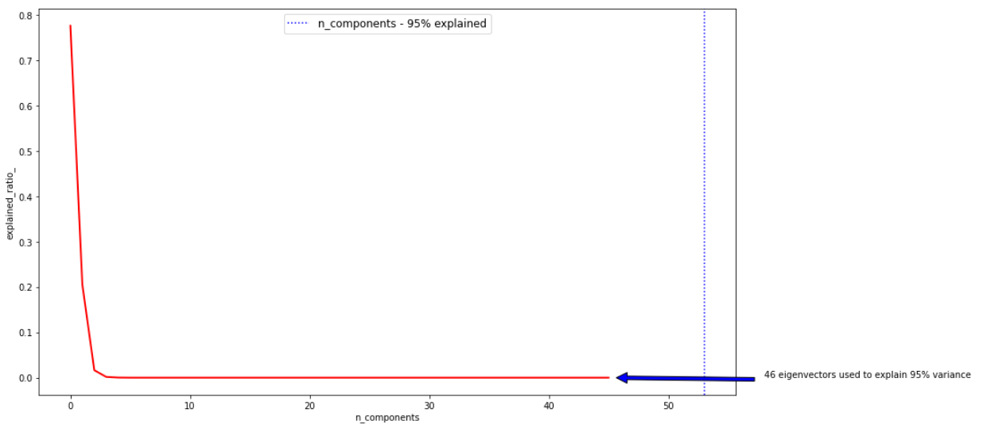
Logistic Regression using PCA – 2 Components
After the pre-processing of the data we were left with 20 features. However, we tried analysing the data using PCA. Using 2 principal components.
This has captured 96% variance from data.
Using PCA we tried grouping the features into 2 Components and later on run logistic regression with SMOTE.
AUC obtained is 50.24%
Accuracy of the model is 52.47%
Sensitivity of the model is 47.95%
Specificity of the model is 53.52%
Fig: AUC Plot
Confusion Matrix
 | Model Prediction
Actual loan status |  | No Default | Default
 | No Default | 343565 | 298305
 | Default | 78068 | 71932

Slide 42
Data Pre-Processing – Contd..
Data type Conversion:
We ensured that assigned data types are correct. For example, ‘pub_rec’, ‘open_acc’, ‘total_acc’, ‘mort_acc’ were converted to integer data type from the original float data type
Dropped rows having loan status as Current, In Grace Period, Late (31-120 days), Late (16-30 days), Default (only 3 records) as we wanted to focus on only 2 status Fully paid & Charged off
Also replaced ‘Does not meet the credit policy. Status: Fully Paid status’ to Fully Paid and ‘Does not meet the credit policy. Status: Charged Off’ to Charged Off in loan_status column.

Slide 43
Application & Future Scope
Applications of the project are:
Increasing the number of lenders and borrowers on the P2P lending platform
Increase profits for the lenders by reducing the risk of default and maximizing returns
Decrease rejection rates and optimize interest rates for borrowers
Future Scope
One of the future scopes of this project would be to collect India’s P2P platforms data and learn
from Lending club’s modelling done as part of this exercise and use that to profile loan applicants
in terms of probability of default and use that to optimize the investment for lenders.
Interest rate optimization to reduce loan default and customer churn.
Use of social parameters for predicting loan default

Slide 44
Actionable Insights
Recommendations that we want to provide from this project are
Probability of default that an applicant will default
Categorize the applicants into high risk, medium risk and low risk
Provide recommendations to investors on how to diversify their portfolio of P2P loans so as to minimize risk of loan default while maximizing returns
Key challenge of P2P lending model revolves around the ability to assess risk for borrowers. This presents the following changes:
Higher interest and rejection rates - inability to perform the right level of risk assessment results in higher rejection rates or interest rates. This keeps many potential borrowers away from the
system.
Perceived high risk of investments - while the P2P model in general have higher risk relative to
some of the traditional lending models, relative lack of regulations and knowledge of the model
makes the situation worse for investors so far few of them want to invest in P2P lending

